Slide 1
Overview of CHPC
Wim R. Cardoen, Staff Scientist
Center for High Performance Computing
wim.cardoen@utah.edu
Spring 2011

Slide 2
Overview
CHPC Services
Arches, Updraft and Ember (HPC Clusters)
Access and Security
Batch (PBS and Moab)
Allocations
Getting Help

Slide 3
CHPC Services
HPC Clusters (talk focus)
Advanced Network Lab
Multi-Media consulting services
Campus Infrastructure Support
Statistical Support
http://www.chpc.utah.edu/docs/services.html

Slide 4
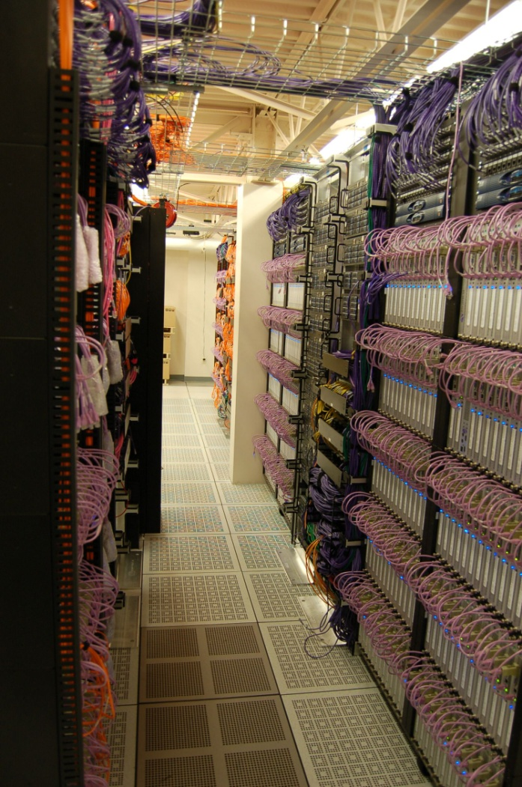
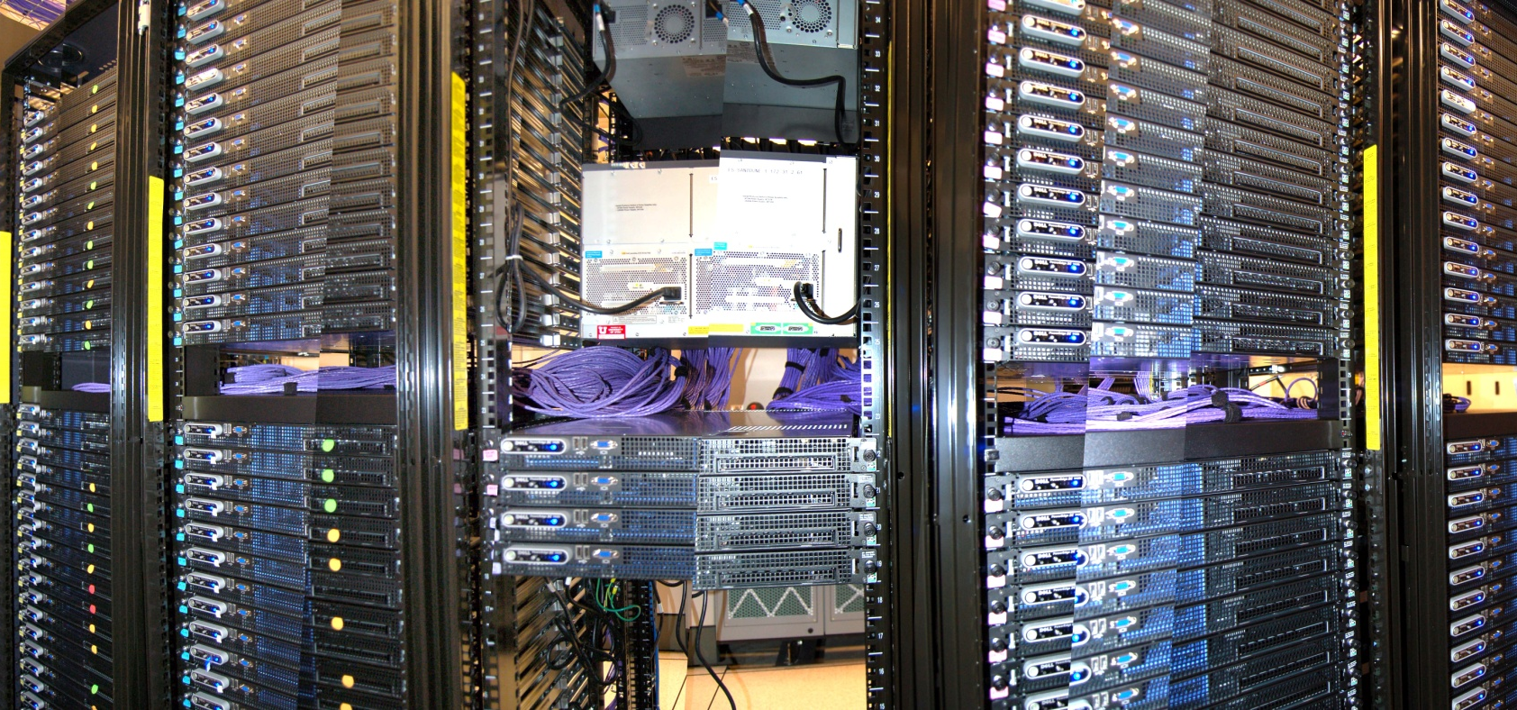
Arches

Slide 5
Arches continued
Sand Dune Arch – 2.4 Ghz/2.6 Ghz cores
156nodes (2.4 Ghz) X 4 cores per node, 624 cores
96 nodes (2.66 Ghz) X 8 cores per node, 768 cores
Turret Arch – interactive stats support
Administrative nodes

Slide 6
Arches continued:
Each cluster has its own interactive login nodes – use ssh2 client.
sanddunarch.chpc.utah.edu
turretarch.chpc.utah.edu
You may interact with queues of any cluster from any interactive node (including updraft/ember)!

Slide 7
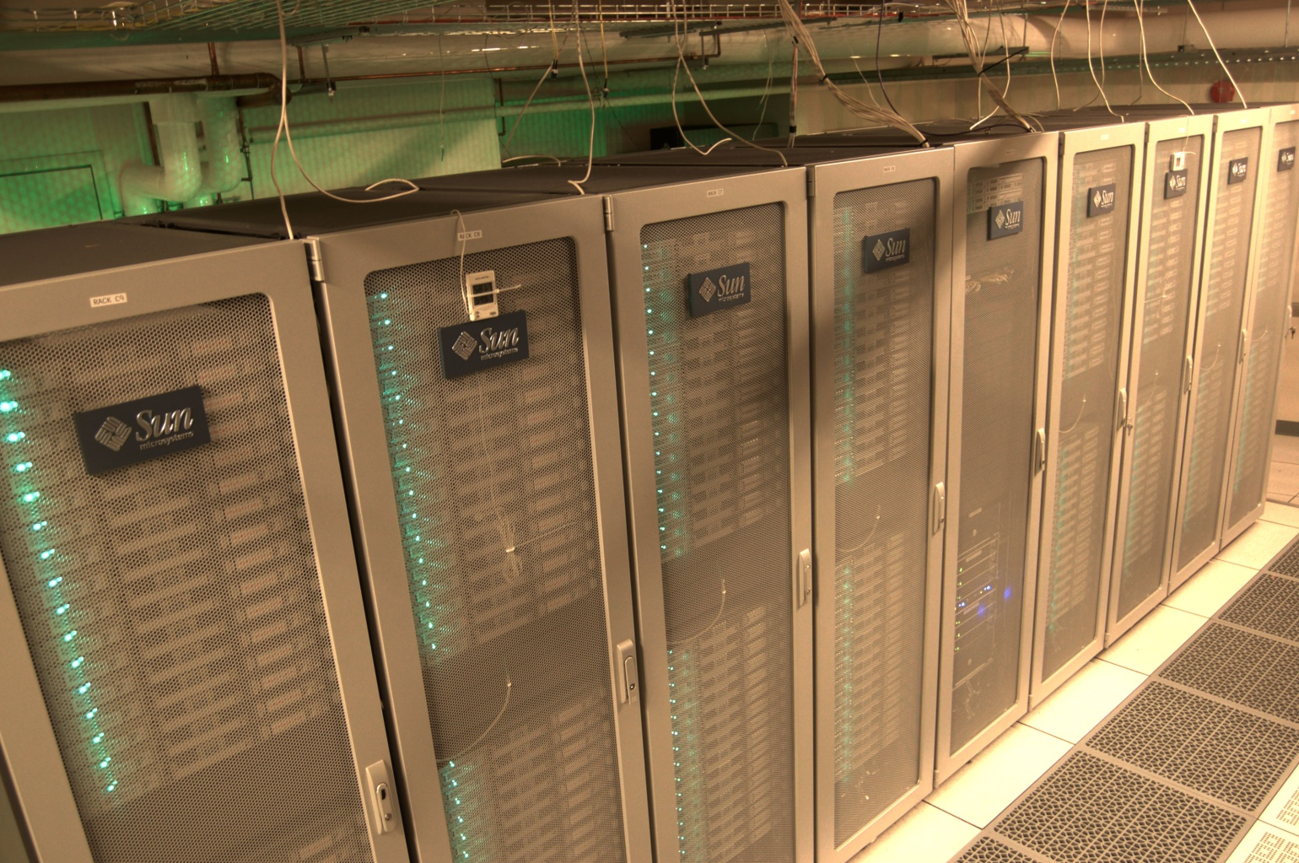
Updraft

Slide 8
Updraft continued
256 dual-quad core nodes (2048 cores)
Intel Xeon 2.8 Ghz cores
Interactive node: updraft.chpc.utah.edu
Configuration Similar to Arches
Policies somewhat different from Arches

Slide 9
Ember

Slide 10
Ember continued
262 dual-six core nodes (3144 cores)
2 GB memory per core (24 GB)
Intel Xeon 2.8 GHz cores (Westmere)
Interactive node: ember.chpc.utah.edu
Configuration Similar to Arches

Slide 11
Updraft
256 nodes/2048 cores Infiniband and GigE
Sand Dune Arch
252 nodes/1392 cores
Infiniband and GigE
Ember
262 nodes/3144 cores Infiniband and GigE
schuster-sda
Switch
molinero-sda
PFS
/scratch/ibrix
tj-sda
zpu-sda
/scratch
Turret Arch
NFS
Telluride cluster
Meteorology cluster
NFS
Administrative
Nodes
Home Directories

Slide 12
Filesystems
CHPC home directory space NFS mounted on all HPC platforms
/uufs/chpc.utah.edu/common/home/<uNID>
Home directories not backed up (some exceptions)
Periodic Archive Option available
Scratch space for HPC systems
Arches: /scratch/serial, /scratch/general
Updraft: /scratch/serial, /scratch/general, /scratch/uintah,
/scratch/ibrix/[chpc_gen,icse_cap,icse_perf]
Notes:
/scratch/parallel going away, may come back as something else.

Slide 13
Ember: /scratch/serial, /scratch/general,
/scratch/ibrix/[chpc_gen,icse_cap,icse_perf]
Files older than 30 days eligible for removal

Slide 14
Filesystems
Access speed based on connectivity
Local disk fastest – local to each node
/scratch/local – not fully supported
NFS
/scratch/serial,/scratch/general,/scratch/uintah
home directories (don’t use for large i/o!)
/uufs/chpc.utah.edu/common/home/<uNID>
PFS
/scratch/ibrix/{chpc_gen,icse_cap,icse_perf}

Slide 15
Scratch Space – not backed up
Arches
/scratch/serial (16 TB)(also on updraft/ember)
/scratch/general (4 TB) (idem)
Updraft
/scratch/serial (16 TB)
/scratch/general (4 TB)
/scratch/unitah (8 TB)
/scratch/ibrix/icse_perf (48 TB)
Notes:
Arches /scratches are mounted on all interactives – available only on specified clusters
Updraft only on updraft

Slide 16
- /scratch/ibrix/chpc_gen (exception: compute nodes)
- /scratch/ibrix/icse_cap (124 TB)
Ember
- /scratch/serial (12 TB)
- /scratch/general (4 TB)
- /scratch/ibrix/icse_perf (48 TB)
- /scratch/ibrix/icse_cap (124 TB)
- /scratch/ibrix/chpc_gen (62 TB)

Slide 17
Getting an Account
Application Procedure
http://www.chpc.utah.edu/docs/forms/application.html
Fill out form online or print locally or send in or fax
Email from established PI’s is acceptable, include unid, and contact information (email minimum)
CHPC uses the campus uNID and password
Passwords maintained by the campus information system
Notes:
Will be changing to web maintenance.

Slide 18
Logins
Access – interactive sites
ssh sanddunearch.chpc.utah.edu
ssh updraft.chpc.utah.edu
ssh ember.chpc.utah.edu
No (direct) access to compute nodes

Slide 19
Security Policies
No clear text passwords, use ssh and scp
You may not share your account under any circumstances
Don’t leave your terminal unattended while logged into your account
Do not introduce classified or sensitive work onto CHPC systems
Use a good password and protect it

Slide 20
Security Policies
Do not try to break passwords, tamper with files etc.
Do not distribute or copy privileged data or software
Report suspicians to CHPC (security@chpc.utah.edu)
Please see http://www.chpc.utah.edu/docs/policies/security.html for more details

Slide 21
Getting Started
CHPC Getting started guide
www.chpc.utah.edu/docs/manuals/getting_started
CHPC Environment scripts
www.chpc.utah.edu/docs/manuals/getting_started/code/chpc.tcshrc
www.chpc.utah.edu/docs/manuals/getting_started/code/chpc.bashrc
Notes:
New accounts now get these copied into home directory automatically.

Slide 22
Environment
All new accounts provided with login or “dot” files.
You should update these files periodically
On the web at http://www.chpc.utah.edu/docs/manuals/getting_started/code
chpc.bashrc, chpc.tcshrc
e.g. “wget http://www.chpc.utah.edu/docs/manuals/getting_started/code/chpc.tcshrc”

Slide 23
Environment – cont.
Running the CHPC environment script will set your path correctly for that cluster using the $UUFSCELL environment variable.
But you may access other clusters by specifying full path:
If your are logged into one of the sanddunearch nodes the path /uufs/$UUFSCELL/sys/bin is added to your PATH env variable
$UUFSCELL will be set to sanddunearch.arches
showq will show you the queues for SDA
To check the queues on updraft, run the command using the full path /uufs/updraft.arches/sys/bin/showq
Notes:
Demo

Slide 24
Batch System
Two components
Torque (OpenPBS )
Resource Manager
Moab (Maui) Scheduler
Required for all significant work
Interactive nodes only used for short compiles, editing and very short test runs (no more that 15 minutes!)

Slide 25
Torque
Build of OpenPBS
Resource Manager
Main commands:
qsub
qstat
qdel
Used with a scheduler
Notes:
Demo

Slide 26
Simple Batch Script
#PBS -S /bin/bash
#PBS -l nodes=2:ppn=4,walltime=1:00:00
#PBS -M username@utah.edu
#PBS -N myjob
# Create scratch directory
mkdir -p /scratch/serial/$USER/$PBS_JOBID
# Change to working directory
cd /scratch/serial/$USER/$PBS_JOBID
# Copy data files to scratch directory
cp $HOME/work_dir/files /scratch/serial/$USER/$PBS_JOBID
#Execute Job
source /uufs/sanddunearch.arches/sys/pkg/mvapich/std/etc/mvapich.sh
/uufs/sanddunearch.arches/sys/pkg/mvapich/std/bin/mpirun_rsh -rsh -np 8 -hostfile $PBS_NODEFILE ./hello_4
# Copy files back home and cleanup
cp * $HOME/work_dir && rm –rf /scratch/serial/$USER/$PBS_JOBID
Notes:
One time you must create the /scratch/serial/$USER directory.

Slide 27
Moab scheduler
Used on all HPC systems
Enforces policies
Sets priorities based on:
qos
out of allocation (“free cycle”)
Optimizes throughput on the system

Slide 28
Moab cont.
Main commands:
showq
-i (idle jobs)
-r (running)
-b (blocked)
showstart <jobnumber>
checkjob <jobnumber>
Notes:
Demo

Slide 29
Batch Policies - Sanddunearch
Time limits
default – 72 hour wallclock
qos=long – 30 days wallclock limit (max. 2 jobs concurrently)
Out of allocation (qos=freecycle)
lowest priority
subject to all general user restrictions
Use “pbsnodes –a“ for node availability
Max #cores: 312 (1/2 of the cluster)

Slide 30
Batch Policies - Updraft
QOS and Time limits
qos=general – 24 hour wallclock limit (preemptor)
qos=bigrun – 72 hour wallclock limit - min #cores: 512 (preemptor)
qos=freecycle – 24 hour wallclock limit lowest priority (preemptee)
Use “pbsnodes –a“ for node availability – also on web
Reservations
Test: 2 nodes, 16 cores
Uintah: 169 nodes, 1352 cores
General: 85 nodes, 680 cores/

Slide 31
Batch Policies - Ember
Qos and Time limits
qos=general - 48 hours wallclock limit (preemptor)
qos=long - 14 days wallclock limit (preemptor) #maxproc:24
qos=freecycle - 48 hours wallclock limit (preemptee)
Use “pbsnodes –a“ for node availability – also on web

Slide 32
Trouble Shooting
Won’t start:
showq –i
diagnose –p
mdiag [–v] -j <jobnumber>
qstat –f <jobnumber>
qstat –n (on running to get nodes)
showstart
mshow –a –w [qos=general]

Slide 33
Allocations
Enforced on arches, updraft and ember
1 SU = 1 Wallclock hour on 2 Ghz core
Examples:
1 hour on 1 ember node is (2.8/2) * 12 = 16.8 Sus
1 hour on 1 updraft node is (2.8/2) * 8 = 11.4 Sus
1 hour on 1 sanddunearch nodes is (2.4/2) * 4 = 4.8 SUs
Node sharing not allowed – charged for entire node(s) assigned to your job

Slide 34
Allocations cont.
Requests for up to 4 quarters at a time due:
September 1st (for Oct-Dec period)
December 1st (for Jan-Mar period)
March 1st (for Apr-Jun period)
June 1st (for Jul-Sep period)
Next Allocations Due September 14th (Mon)
Allocation should be completed online:
http://jira.chpc.utah.edu
Create new issue → allocation request

Slide 35
Allocations cont.
Quick allocations may be made for up to 5000 SU’s for the current quarter only
Unused allocations may not be carried forward to next quarter
Allocation and Usage data on CHPC web site

Slide 36
Getting Help
http://www.chpc.utah.edu
Email: issues@chpc.utah.edu (Do not email staff members directly – or cc)
http://jira.chpc.utah.edu
Help Desk: 405 INSCC, 581-6440 (9-5 M-F)
chpc-hpc-users@lists.utah.edu
Notes:
Show web page and how to get around.
Show jira system

Slide 37
Upcoming Presentations
All presentations are on Thursdays INSCC Auditorium, 1-2 p.m.
3/31: Intro to IO in the HPC environment (Brian Haymore and Sam Liston)
4/7: Introduction to Parallel Computing (Martin Cuma)
4/14: Intro to MPI (Martin Cuma)
4/21: Gaussian09 and GaussView (Anita Orendt)
5/5: Interplay – Another language, telematic performance (Jimmy Miklavcic)
Presentation at Upper Campus
4/28: HIPAA, AI, NLP (Sean Igo)
http://www.chpc.utah.edu/docs/presentations/
If you would like training for yourself or your group, CHPC staff would be happy to accommodate. Please contact julia.harrison@utah.edu to make arrangements.

